Slide 1
ANJEE: THE ALLIANCE OF NEW JERSEY ENVIRONMENTAL EDUCATION
Taking a Stand on Marine Debris and Ocean Pollution
Clean Ocean Action Conference
Brookdale Community College
November 11, 2014

Slide 2
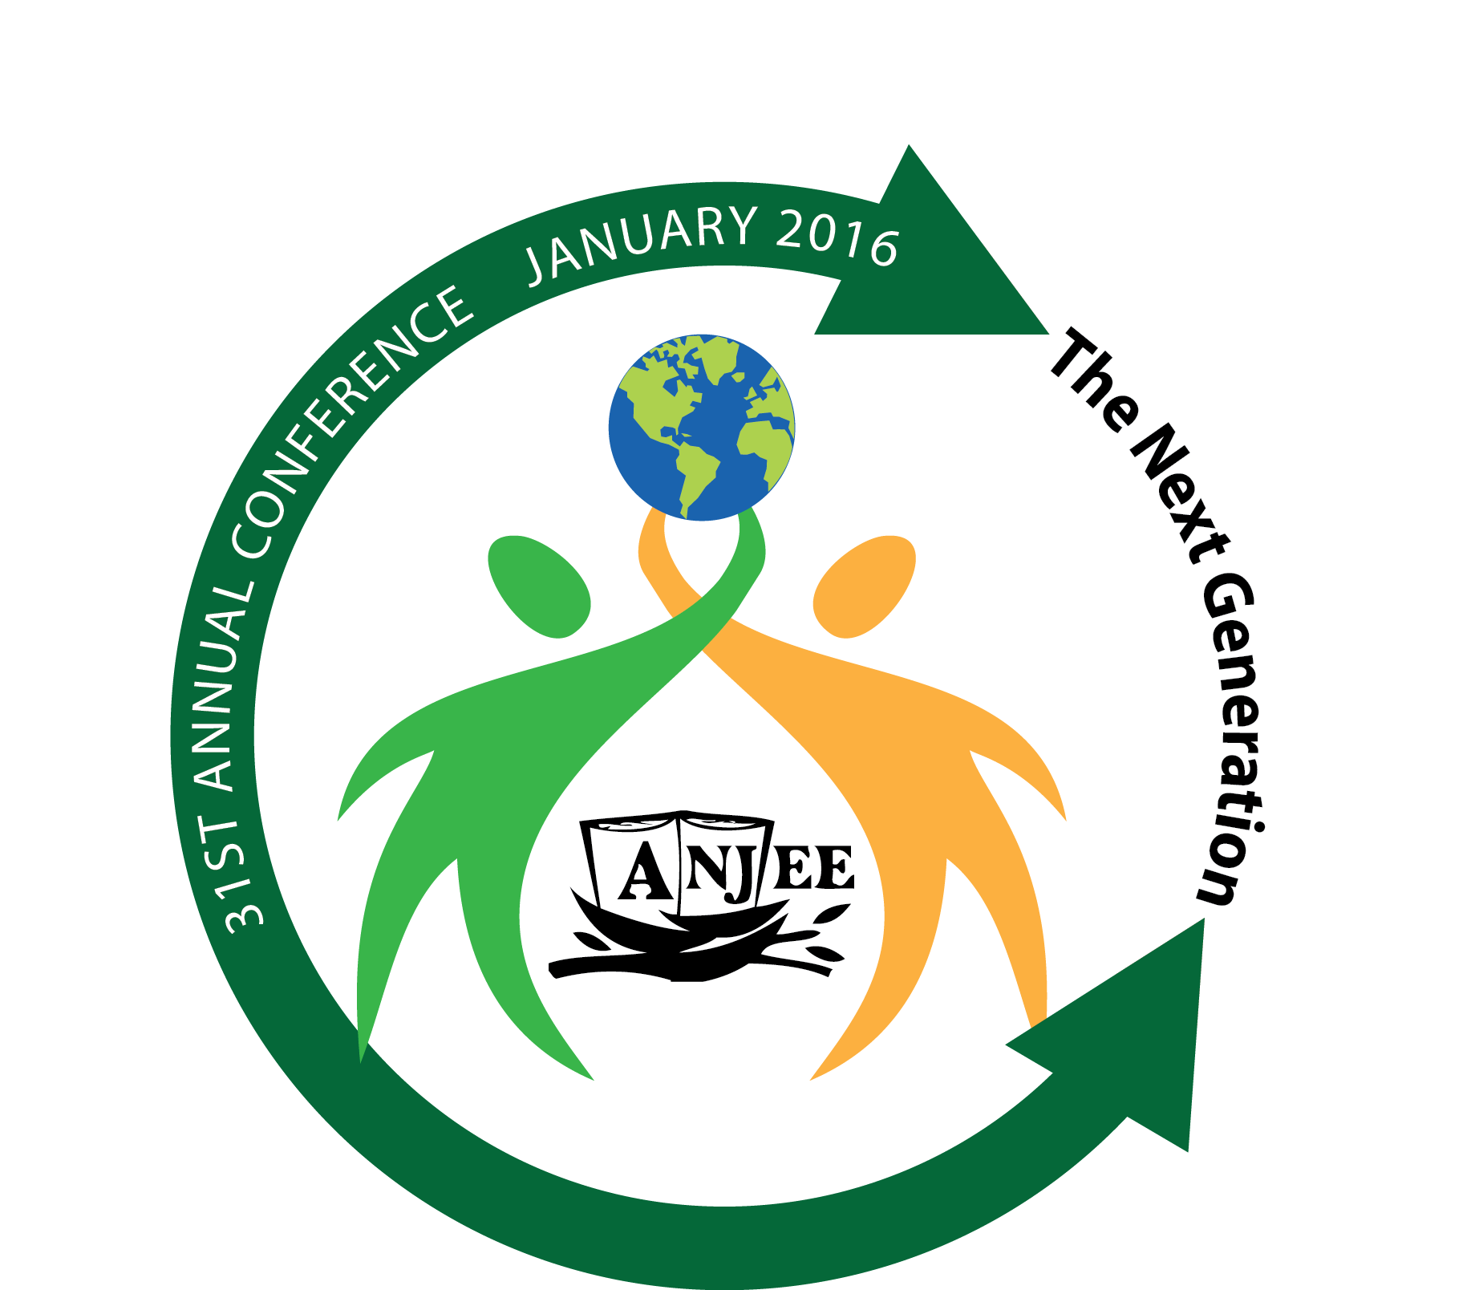
The Alliance for New Jersey Environmental Education

Slide 3
Who we are
ANJEE has been promoting environmental education in New Jersey for over 30 years. We are the NJ affiliate of the North American Alliance for Environmental Education. Our annual conference is the premiere Environmental Education event in New Jersey.
ANJEE is a member organization of over 400 members, including non-formal, and formal educators, as well as member organizations throughout the state.
Many of our organizations also serve as Host Agencies for the NJDEP/AmeriCorps Watershed Ambassadors Program.

Slide 4
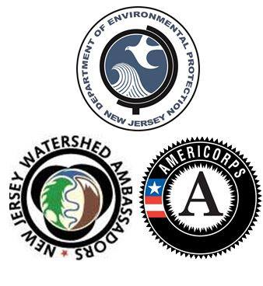
Water education, marine debris and ocean pollution
Each Watershed Ambassador provides 1700 hours of service including free watershed programs in schools and other venues, state-wide NJDEP water testing and monitoring, community engagement, and volunteer recruitment. Through these programs watershed ambassadors engage thousands of students and citizens to protect our waters.

Slide 5
What more can Anjee do?
Expand outreach and be more of a clearinghouse of available programs, professional development and technical assistance
Increase programming about marine debris and ocean pollution
Develop the ANJEE regions and programs
Create stronger partnerships with and participation of formal educators
Advocate for No Child Left Inside and Environmental Literacy
Advocate beyond EE (not permitted in Bylaws)

Slide 6
The Role of Technology
Through the use of social media and other technology platforms, students can now create networks and partnerships with other students anywhere in the world.
The power of student 2 student/school 2 school partnership engages and motivates students to increase their handprint at the same time they decrease their footprint.
Projects such as GenNXT green news in @ction, iEARN, YOUTHCaN, NWF/FEE Young Reporters, and Our Rock are just a few examples.
In addition, GIS and other mapping tools, global on-line data-bases, NOAA, Ocean Conservancy, etc. can vastly increase access to and involvement in Real World, Action Oriented, Authentic Exhibitions of Student Learning.

Slide 7
The Solution: It is time to flip what has been the Thinking and approach to environmental education and community action.
Among the most recognizable responses to the issues of water pollution have been reflected in the following bumper stickers:
Think Globally, Act Locally
We All Live Downstream

Slide 8
Both of those BS (bumper sticker) Statements have been important in raising awareness, but…
We need to shift from a “recipient/reactive” model, to a model of local action that has a focus on the GLOBAL end game, which extends far wider and deeper than the impact on my community or watershed.
We have been raised to react and deal with what we have received, rather than what we contribute to a problem far larger than the impact on local eco-systems.

Slide 9
What this calls for…
We must “flip” the paradigm of input and actions. It requires a new mind-set of output and impacts.
Instead of the belief, “we all live downstream,” shift our thinking (and bumper stickers) to say, “we all live upstream.”
Instead of the belief, “we need to act locally,” shift to a mindset of “think locally, but act globally.”
This DOES NOT mean we abandon local action. It means that whenever we think about our community issues needs to be embedded in actions that can be measured in line with actions elsewhere to reduce environmental damage beyond our immediate sphere of influence.

Slide 10
FOR MORE INFORMATION ABOUT ANJEE OR ANY RESOURCES MENTIONED
COMMUNICATIONS@ANJEE.ORG
FOR ANJEE 31ST CONFERENCE INFO AND REGISTRATION:
WWW.ANJEE.ORG
JANUARY 21-23, 2016,
CROWNE PLAZA, PLAINSBORO, NJ

