Slide 1
Debbie Mans, Executive Director & Baykeeper
Debbie@nynjbaykeeper.org
732-888-9870
www.nynjbaykeeper.org

Slide 2
Citizen Science Monitoring for Pathogen Indicators in the NY-NJ Harbor
Why is this Project important?
Monitoring sites are not currently monitored by Monmouth County Dept. of Health or NJDEP
Although not designated as bathing beaches, sites are used for recreation and swimming
Project will benefit the communities of the lower Raritan River and Raritan Bay
Increase knowledge base of the local environment and help citizens make usage decisions
Add to overall data on water quality and issues regarding public safety for recreation use, habitat enhancement, regulatory decisions and biodiversity

Slide 3
9 Monitoring Sites
1) Rt. 35 Bridge, Perth Amboy
2) 2nd Street, Perth Amboy
3) Raritan Yacht Club near the mouth of the Arthur Kill
4) Fisherman’s Beach, South Amboy
5) Paul’s Beach, Old Bridge Township
6) Cliffwood Beach Waterfront Park, Aberdeen Township
7) Cedar Street, Keyport
8) Beachway Ave and Raritan Ave, Keansburg
9) Port Monmouth Road, Middletown
*green sites currently monitored by NJDEP/Monmouth County

Slide 4
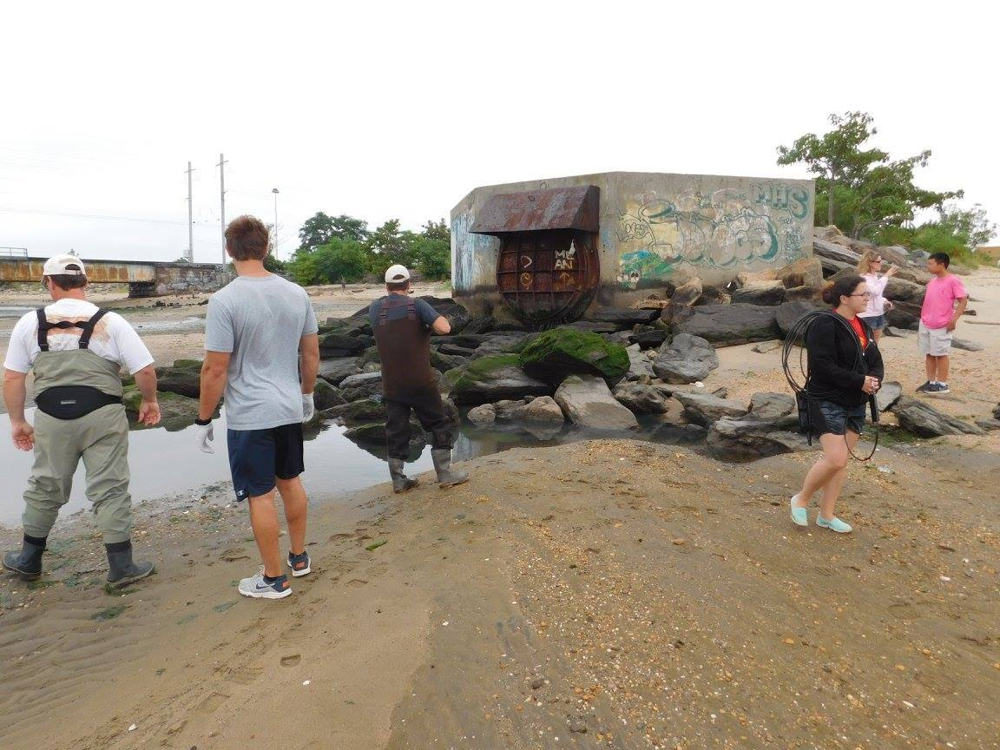
Results
Location | June 13 | June 20 | June 27 | July 7 | July 11 | July 18 | August 1 | August 8
Port Monmouth Rd. at Bayshore Waterfront Park-West of Pews Creek
Beachway Ave, Keansburg
Cedar St., Keyport
Cliffwood Beach Waterfront Park, Aberdeen Township
Paul’s Beach, Laurence Harbor
Fishermen’s Beach, South Amboy
Route 35 (Victory) Bridge, Perth Amboy
End of 2nd Street, Perth Amboy
Raritan Yacht Club, Water Street, Perth Amboy
Red indicates that the area is unsafe for swimming due to pathogens (above 35 MPN/100 ml) (Most Probable Number of colonies).
Method: Enterolert with the IDEXX trays.
Funding through US EPA and Harbor & Estuary Program grant.
All data is conditional.

Slide 5
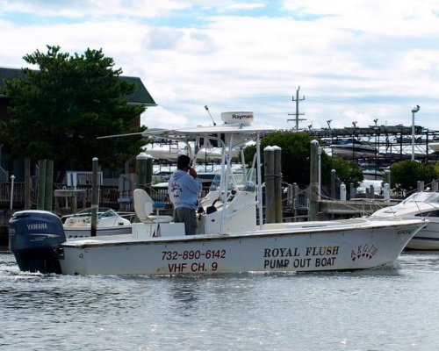
ROYAl flush pumpout boat
New this season, NY/NJ Baykeeper is operating Monmouth County’s pumpout boat on the Navesink and Shrewsbury Rivers.
The Royal Flush operates Fridays and Saturdays from July 1 to October 1, 2016 (weather permitting).
Boaters can contact the Royal Flush on VHF Channel 9 by radio on days of operation or by cell at 732-890-6142. Service provided on a first come, first serve basis.
As of July 4th weekend, our operators have pumped out 225 boats, preventing 6,500 gallons of waste and chemicals from potentially being dumped into local waterways!

